Slide 1

Infrastructure Event Management using PowerShell
Chendrayan Venkatesan (Chen V)
@ChendrayanV

Slide 2
PS C:\> WhoAmI
Chendrayan Venkatesan (Chen V)
CDM MVP | MCTS SharePoint | MCP Exchange | ITIL V3 Foundation
Twitter : @ChendrayanV
LinkedIn : https://www.linkedin.com/in/chendrayanv/
An IT Professional one who use PowerShell at workplace to solve customer requirements! Strongly believe in the saying “Learning is a continuous process!”

Slide 3

Why PowerShell? Why can’t we use the procured tools?
Sit back and relax! We are here to help you!

Slide 4
Inspired from……..
We Offer THREE kinds of service
GOOD-CHEAP-FAST
Pick any two
GOOD service CHEAP won’t be FAST
GOOD service FAST won’t be CHEAP
FAST service CHEAP won’t be GOOD
___________________________________________
☺ ☺ ☺

Slide 5
Agenda
API Introduction
BPPM / TrueSight – PowerShell way to do CRUD
HPSM9 SOAP to REST – PowerShell to save the sanity
Fuse API with PowerShell and solve the complexity.
Get-Started
Demo

Slide 6
API Introduction
Application Programming Interface
An Engine Under the Hood.
A messenger to convey our needs to system to get the job done!
Is a set of subroutine definitions, protocols and can be a tool for building applications.
A good API allows us to interact with a system in very easy manner.
It’s required for both IT Professionals and developers to work in any infrastructure for solving customer requirements.

Slide 7
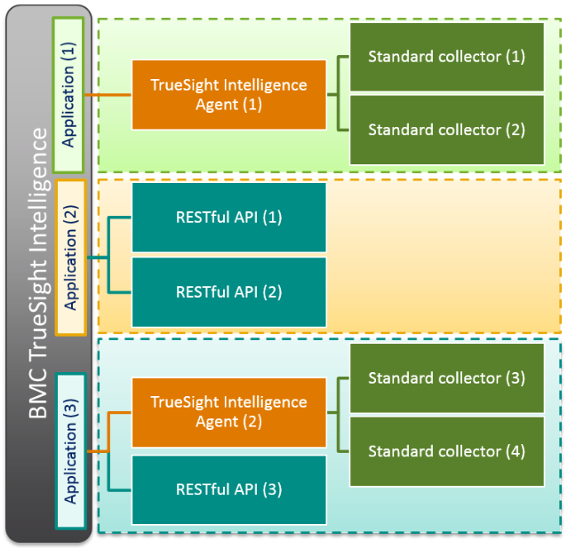
BMC TrueSight Intelligence!

Slide 8
TrueSight API - Possibilities
Creating / changing dashboards
Sending measurements to graphs
Creating sub-accounts
Adding / listing account users
CRUD Operations.
Documentation

Slide 9
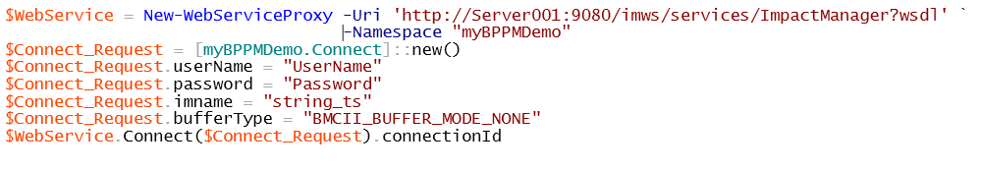
PowerShell | New-WebServiceProxy
Yes, it’s SOAP so New-WebServiceProxy will solve our need.

Slide 10
Demo

